Slide 1
Treatment Utilization Before Suicide (TUBS)
*
Specific Aims:
  Identify the types/timing of defined diagnoses prior to suicide (cases only; hypothesis-driven).
  Compare defined diagnoses, visit types, demographics (case-control; hypothesis driven)
  Environment-wide association study (EWAS) to detect unknown diagnoses, procedures, visits, medications, and other clinical factors (case-control; hypothesis-generating)
  Develop a prediction model / algorithm for suicide in health systems including factors from Aims 1-3.

Slide 2
TUBS: Project Methods, Timeline
*
Identify all suicide cases and matched controls across 8 health systems, 2000-2014
  ~3,000 suicides across sites; 300,000 controls (1:100 ratio of cases to controls)
    Allows additional analysis of subgroup variation (e.g., variation in factors among adolescents)
  Matched on site and index date (date of death for cases).
  VDW data programs for data extraction developed by HFHS and distributed to all sites.

Slide 3
TUBS Progress
Completed Aim 1; Aim 2 partially complete
  Physical Health Conditions paper accepted in AJPM (Brian Ahmedani)
  Papers submitted
    Firearms Paper (Jenn Boggs)
    Firearms Letter (Jenn Boggs / Greg Simon)
    Dermatology (Deepak Prabhakar)
  Papers in preparation
    Substance Use Disorders (Frances Lynch)
    Traumatic Brain Injury (Rebecca Rossom)
    Suicide Attempt (Deepak Prabhakar)
    Pain / Sleep (Ashli Owen-Smith)
    Visits (Brian Ahmedani)
  Papers planned
    Cancer (Tumor Registry)
    Obesity / BMI
    Antidepressant Adherence
    Child/Adolescent

Slide 4
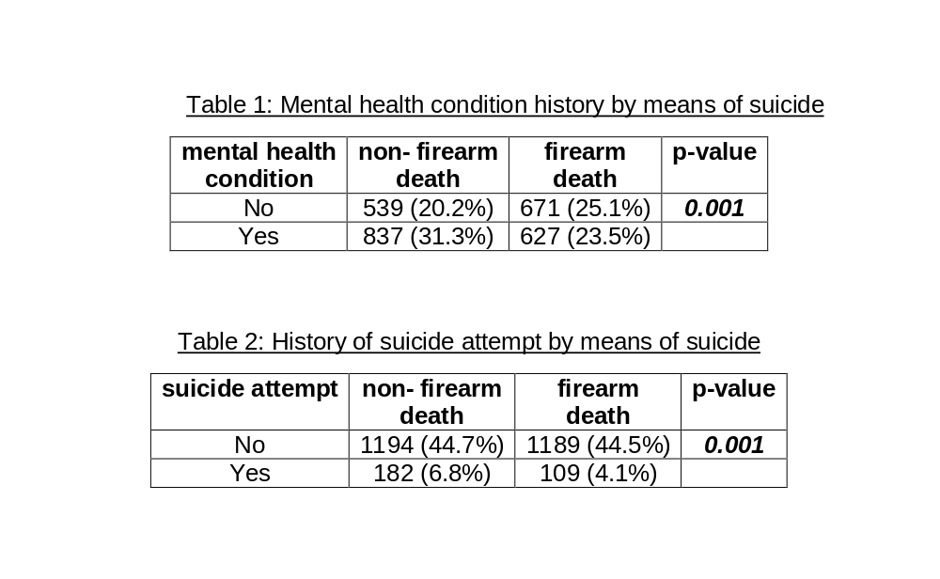
Firearms Letter

Slide 5
Dermatology
 | Control | Case
Diagnosis | % (n) | % (n) | OR(95% CI) | p-value | aOR*(95% CI) | p-value | aOR**(95% CI) | p-value
Psoriasis | 0.77 (2062) | 0.97 (26) | 1.26(0.86, 1.86) | 0.237 | 1.06(0.72, 1.57) | 0.755 | 0.91(0.61, 1.35) | 0.643
Malignant melanoma | 0.13 (336) | 0.22 (6) | 1.79(0.80, 4.01) | 0.159 | 1.20(0.53,2.72) | 0.654 | 1.06(0.46,2.42) | 0.888
Other malignant neoplasm | 0.90 (2403) | 1.91 (51) | 2.15(1.62, 2.84) | 0.001 | 1.22(0.92,1.63) | 0.164 | 1.15(0.87, 1.54) | 0.331
Benign neoplasm | 3.09 (8274) | 1.80 (48) | 0.57(0.43, 0.76) | 0.001 | 0.57(0.43, 0.76) | 0.001 | 0.53(0.40, 0.71) | 0.001
Atopic dermatitis | 1.13 (3018) | 0.67 (18) | 0.59(0.37, 0.95) | 0.028 | 0.84(0.52, 1.33) | 0.448 | 0.77(0.48, 1.24) | 0.28
Contact dermatitis | 4.76 (12719) | 4.97 (133) | 1.05(0.88, 1.25) | 0.592 | 1.02(0.85, 1.22) | 0.838 | 0.90(0.75, 1.08) | 0.251
Erythematous conditions | 1.06 (2831) | 1.12 (30) | 1.06(0.74, 1.53) | 0.744 | 1.03(0.72, 1.48) | 0.872 | 0.90(0.62, 1.30) | 0.571
Pruritus | 0.85 (2277) | 1.20 (32) | 1.41(1.00, 2.01) | 0.053 | 1.35(0.95, 1.92) | 0.098 | 1.09(0.76, 1.56) | 0.633
Other skin disease | 13.83 (36980) | 17.61 (471) | 1.33(1.26, 1.47) | 0.001 | 1.12(1.01, 1.24) | 0.028 | 0.98(0.88, 1.08) | 0.661
Acne | 2.25 (6014) | 1.72 (46) | 0.76(0.57, 1.02) | 0.068 | 1.21(0.90, 1.63) | 0.2 | 1.04(0.77, 1.40) | 0.814
Alopecia | 0.41 (1100) | 0.52 (14) | 1.28(0.75, 2.16) | 0.368 | 1.69(0.99, 2.87) | 0.053 | 1.39(0.82, 2.38) | 0.226
Any of above | 20.33 (54364) | 23.15 (619) | 1.18(1.08, 1.29) | 0.001 | 1.07(0.97, 1.17) | 0.165 | 0.92(0.84, 1.01) | 0.096

Slide 6
Timeline
Year 3
  Complete Aim 2
  Begin Aim 3
    EWAS data program
Year 4
  Begin Aim 4
    Algorithm

